Slide 1
UVA Landmark Recognition
Sam Nadjari

Slide 2
The Dataset
Images of buildings across UVA campus collected by students
2,138 total images
18 classes
Dimensions: 224x224x3
Split
Training set: 1196 images
Validation set: 300 images
Test set: 642 images

Slide 3
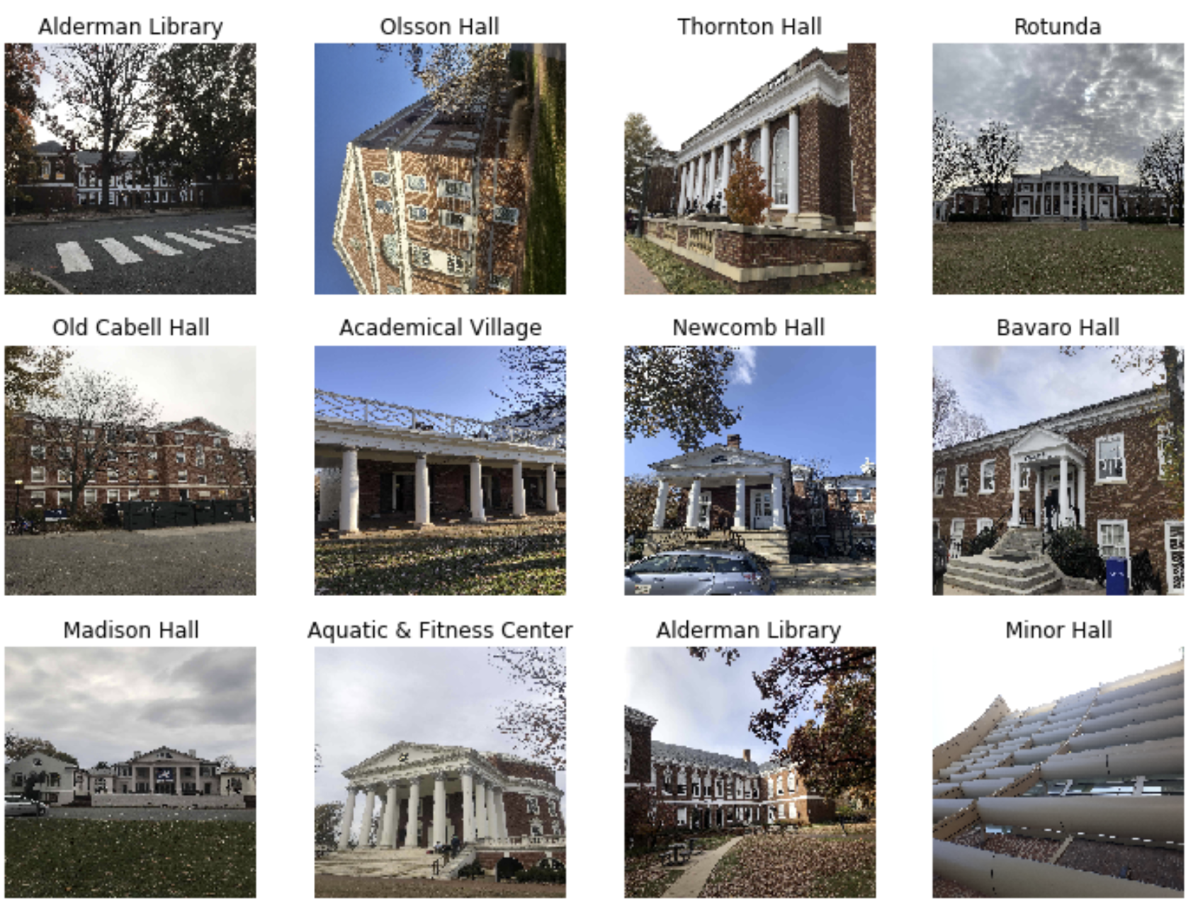

Slide 4
Data Augmentation
Feature-wise centering and normalization
Random crop
<=90° rotation
Brightness range: 70% to full

Slide 5
Model Selection
Tested 3 pretrained models
ResNet50
Inception v3
VGG19
The last layer of each model was removed, and 2 layers were added:
Global average pooling layer
Dense layer with 18 neurons
All layers besides the final dense layer were frozen
Each model was trained for 10 epochs using the same parameters:
Batch size: 32
Optimizer: SGD with lr=0.02, momentum=0.9, nesterov=True
Loss function: cross entropy

Slide 6
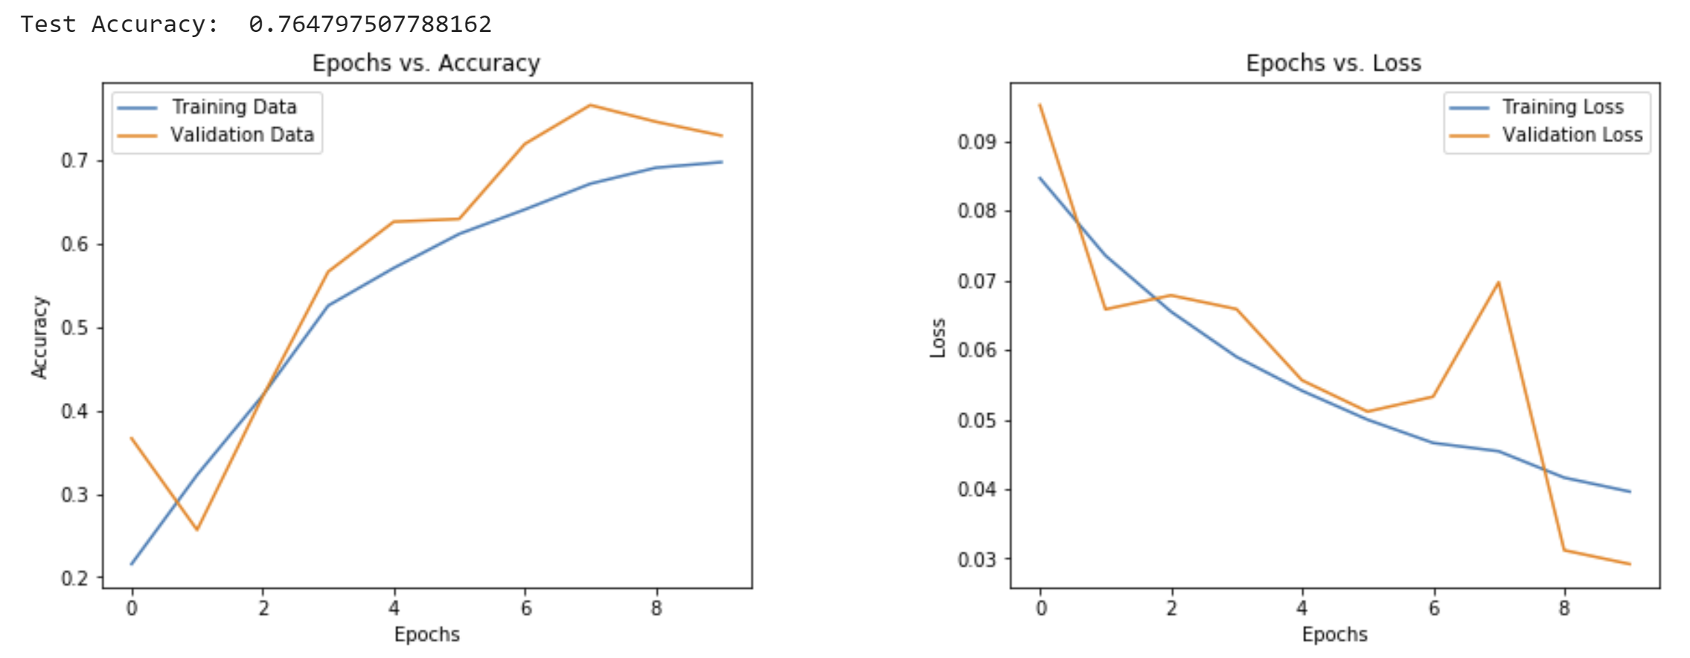
Model Selection
ResNet50: 76% accuracy on test set
Inception v3: 73% accuracy on test set
VGG19: 73% accuracy on test set

Slide 7
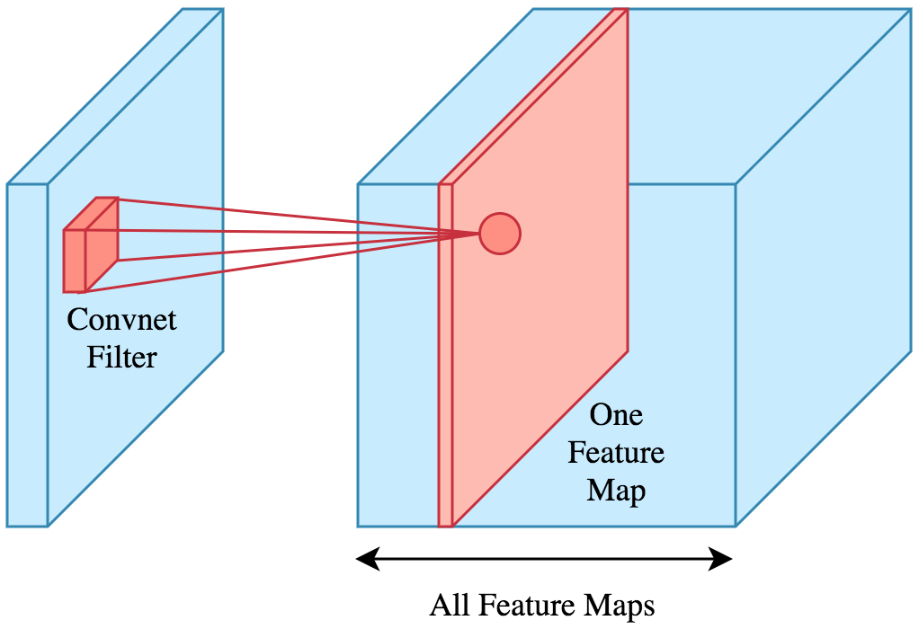
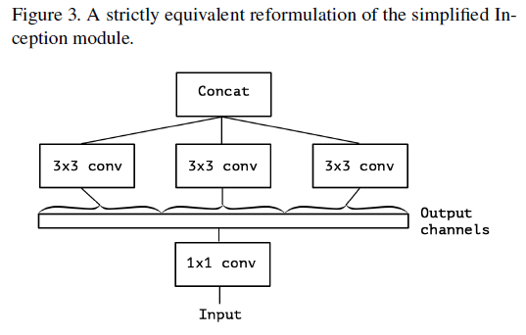
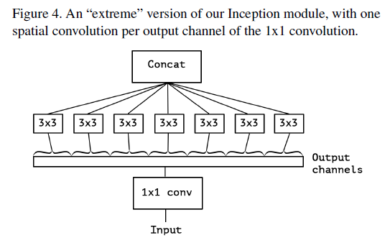
Custom Layers
Depthwise separable convolutional layers
“While Inception modules are conceptually similar to convolutions (they are convolutional feature extractors), they empirically appear to be capable of learning richer representations with less parameters … An “extreme” version of an Inception module, based on this stronger hypothesis, would first use a 1x1 convolution to map cross-channel correlations, and would then separately map the spatial correlations of every output channel.”
- Francois Chollet, Xception: Deep Learning with Depthwise Separable Convolutions
The continuum between convolutions and depthwise convolutions:

Slide 8
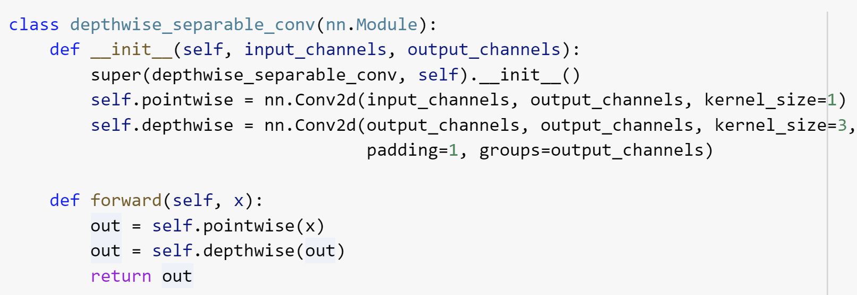
Custom Layers

Slide 9
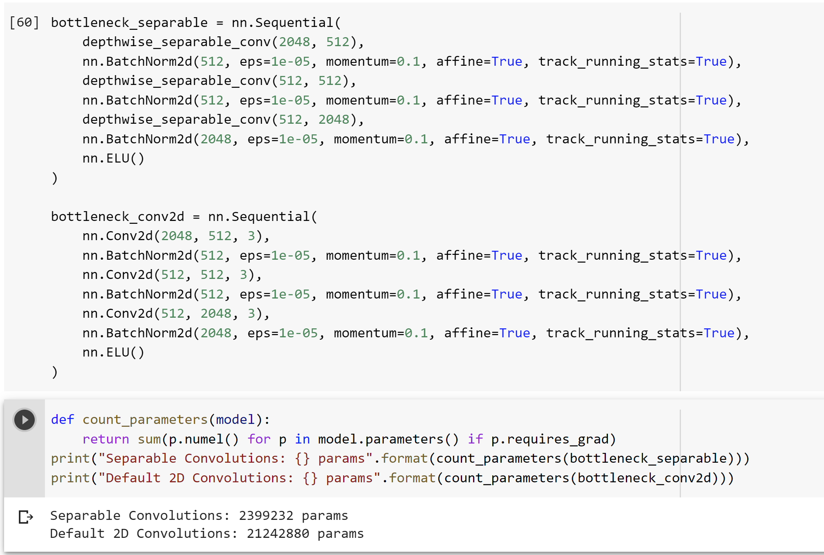
Custom Layers

Slide 10
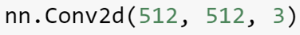
Custom Layers
Pointwise convolution: 512 1x1x512 filters that move 8x8 (spatial dimensions) times = 16,777,216
Depthwise convolutions 512 3x3x1 kernels that move 8x8 times = 294,912
Total multiplications = 17,072,128 (1.7e7)
Total multiplications: 512 3x3x512 kernels moving 8x8 times = 150,994,944 (1.5e8)

Slide 11
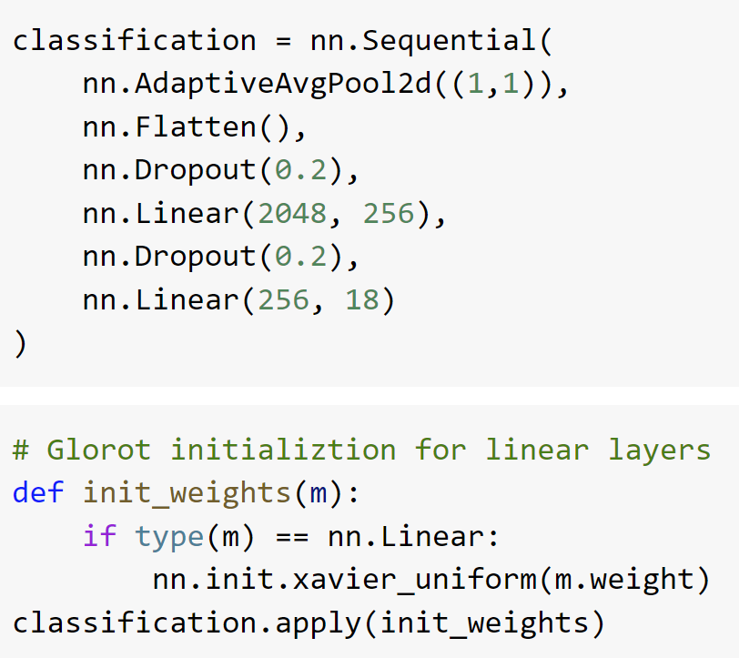
Custom Layers

Slide 12
Training
Round 1
All weights frozen besides custom and classification layers
10 epochs
Initial learning rate = 0.01
Learning rate scheduler: Reduce learning rate by a factor of 10 on plateau
Adam optimizer
Round 2
Unfroze last two bottleneck modules of ResNet
Initial learning rate = 0.001
Same learning rate scheduler, optimizer
20 epochs
Unfreezing deeper layers harmed performance

Slide 13
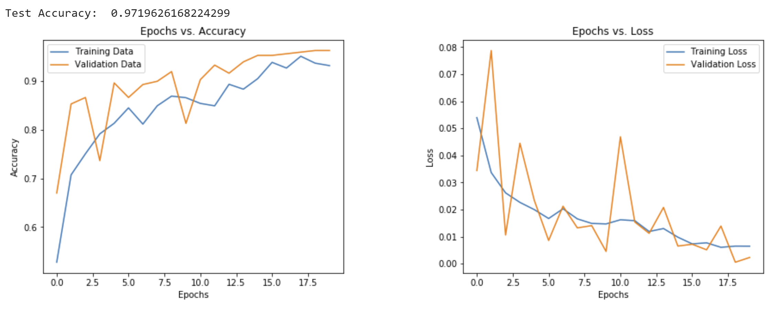
Results

Slide 14
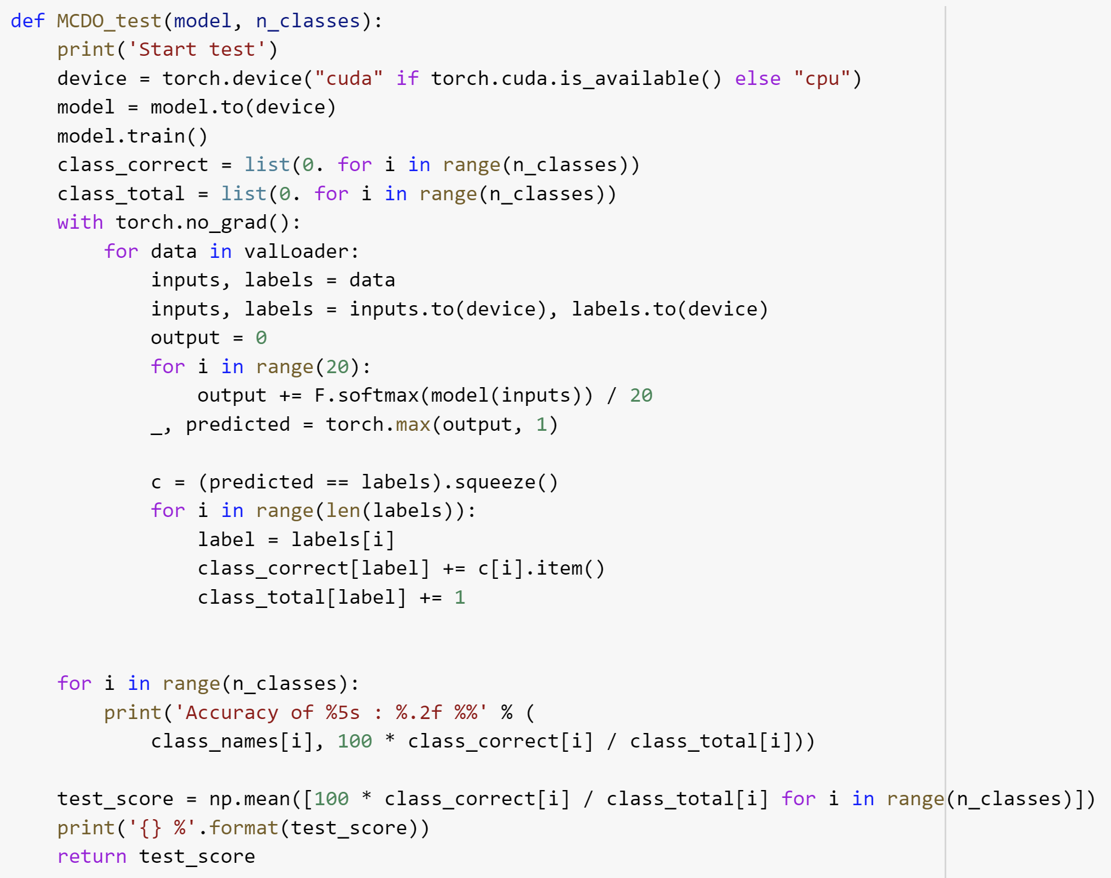
Results
Monte Carlo Dropout offers an approximation of Bayesian inference and an improved measure of uncertainty.
Accuracy: 97.8%
Reduction in error rate due to MC dropout: 21%

